Slide 1

CAP950 OPEN SOURCE TECHNOLIGIES (PHP)
The Kick Start Session

Slide 2

Course details
LTP – 3 0 2 [3-Lecture-2-Practical/week]
Text Book:
PROGRAMMING PHP RASMUS
LERDORF,KEVIN TATROE,
PETER MACINTYRE,
O'REILL

Slide 3

References:
WEB TECHNOLOGIES BLACK BOOK, KOGENT LEARNING SOLUTIONS INC,
DREAMTECH PRESS

Slide 4
Course Assessment Model
Marks break up
Attendance 5
CAP (3 best out of 4) 45
ETP 50
Total 100

Slide 5

The hitch…
Three BURNING questions in mind…
Why we are learning PHP?
What would we do with it?
What will the course outcome?

Slide 6
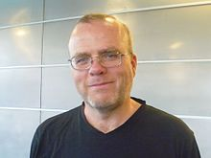
What is PHP?
PHP(Hypertext Preprocessor) is an open-source, interpreted, and object-oriented scripting language that can be executed at the server-side. PHP is well suited for web development.
PHP was created by Rasmus Lerdorf in 1994 but appeared in the market in 1995.

Slide 7
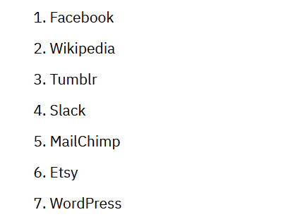
PHP Applications:

Slide 8
PHP used in top industry like:
IndiaNIC InfoTech
Hidden Brains
Clarion Technologies
IntellectSoft
Parangat Technologies
Sparx IT solutions
Net Solutions
Sphinx Solutions
Zealous Systems
FinOit

Slide 9

PHP Job Profiles
PHP developer

Slide 10
PHP is a ............?
Open Source Language
Server side scripting language
above both
none

Slide 11
What do we need to know?
Introduction with language basics
brief introduction to PHP,
lexical structures in PHP,
data types and variables in PHP,
control flow and loops in PHP,
embedding PHP in web pages

Slide 12
What do we need to know?
Functions in PHP
understanding built-in functions of PHP,
defining and calling user defined functions in PHP,
managing parameters in user defined functions,
user defined functions with return values,
variable functions and anonymous functions in PHP

Slide 13
What do we need to know?
Arrays in PHP
different types of arrays supported by PHP,
storing data in arrays,
array functions in PHP,
traversing arrays,
converting between arrays and variables,
sorting arrays in PHP

Slide 14
What do we need to know?
Working with graphics in PHP
embedding an image in web page using php,
creating and drawing images,
images with text,
scaling images,
color handling of images using PHP

Slide 15
What do we need to know?
Working with PDF in PHP
PDF extensions available in PHP,
PDF documents and pages,
putting text in PDF pages using PHP,
inserting images and graphics in PDF with PHP,
navigation in PDF pages using PHP

Slide 16
What do we need to know?
Working with databases in PHP
using PHP to access database,
performing database operations using mysqli,
advanced database techniques

Slide 17
What do we need to know?
Working with XML in PHP
Security features in PHP
generating XML in PHP,
parsing XML with simpleXML,
parsing XML with XSLT.
super global variables in PHP,
files access and uploads using PHP,
file permissions in PHP

Slide 18
The course outcome…
understand the different aspects of server site and client site scripts
apply database concepts for effectively manage data using server site script
apply the parsing technique to read data from other sources
develop dynamic web pages using PHP

Slide 19
PHP developed by…?
Dennis Ritchie
Jorge Thomson
Rasmus Lerdorf
None

Slide 20
Lets start new journey with php….
Introduction with language basics: -
brief introduction to PHP, lexical structures in PHP, data types and variables in PHP, control flow and loops in PHP, embedding PHP in web pages

Slide 21
Php Installation and use
Installation of PHP
How to Execute..?
How to start coding..?

Slide 22
Installation of PHP
Install AMP (Apache, MySQL, PHP) which is available for all operating systems.
WAMP for Windows
LAMP for Linux
MAMP for Mac
XAMPP (Cross, Apache, MySQL, PHP, Perl)

Slide 23
WAMP for Windows
https://www.wampserver.com/en/
For XAMP:
https://www.apachefriends.org/download.html

Slide 24
How to Execute…?
Create one file with extension .php and save in c:/wamp/www folder
And Write down code…
<!DOCTYPE>
<html>
<body>
<?php
echo "<h2>My PHP App</h2>";
?>
</body>
</html>

Slide 25
How to run php page
Open your web browser and type:
localhost/hello.php

Slide 26
Basics in Php
Print any message on screen using Php

Slide 27
Print any message on screen using echo
PHP echo statement can be used to print the string, multi-line strings, escaping characters, variable, array, etc.
<?php
echo "Hello World";
?>

Slide 28
Print any message on screen using print()
print always returns an integer value, which is 1.
Using print, we cannot pass multiple arguments.

Slide 29
Difference between echo and print
echo
echo is a statement, which is used to display the output.
echo can be used with or without parentheses.
echo does not return any value.
We can pass multiple strings separated by comma (,) in echo.
echo is faster than print statement.
print
print is also a statement, used as an alternative to echo at many times to display the output.
print can be used with or without parentheses.
print always returns an integer value, which is 1.
Using print, we cannot pass multiple arguments.
print is slower than echo statement.

Slide 30
Check the difference
<?php
$fname = "Gunjan";
$lname = “Saxena";
echo "My name is: ".$fname,$lname;
?>
<?php
$fname = "Gunjan";
$lname = "Garg";
print "My name is: ".$fname,$lname;
?>

Slide 31
Variable in PHP
In PHP, a variable is declared using a $ sign followed by the variable name.
$variablename=value;
PHP variables are case-sensitive, so $name and $NAME both are treated as different variable.

Slide 32
<?php
$str="hello string";
$x=200;
$y=44.6;
echo "string is: $str <br/>";
echo "integer is: $x <br/>";
echo "float is: $y <br/>";
?>

Slide 33
PHP $ and $$ Variables
The $var (single dollar) is a normal variable with the name var that stores any value like string, integer, float, etc.
The $$var (double dollar) is a reference variable that stores the value of the $variable inside it.

Slide 34
<?php
$x = "abc";
$$x = 200;
echo $x."<br/>";
echo $$x."<br/>";
echo $abc;
?>

Slide 35
Which sign is used to access variable of variable in PHP?
$$
$
#@
$|

Slide 36
PHP Data Types
boolean
integer
float
string

Slide 37
PHP Operators
Arithmetic Operators
Assignment Operators
Bitwise Operators
Comparison Operators
Incrementing/Decrementing Operators
Logical Operators
String Operators
Array Operators
Type Operators
Execution Operators
Error Control Operators

Slide 38
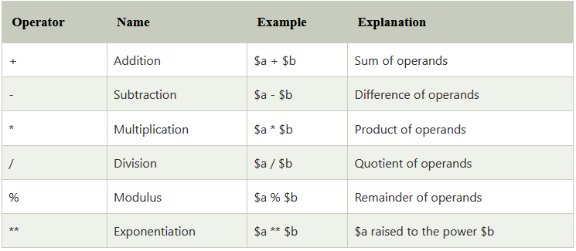
Arithmetic Operators

Slide 39
Read Value from HTML input box using GET
<form method=“get">
<input type="text" name=“myname" class="button"/>
<input type="submit" name=“btnsubmit" value=“SUBMIT"/>
</form>
// php
<?php
$name = $_GET[' myname'];
echo $name;
?>

Slide 40
<html>
<head>
<title>Take input from user</title>
</head>
<body>
<form method="get">
<input type="text" name="name" />
<input type="submit" name="btnsubmit" value="SUBMIT"/>
</form>
<?php
if(empty($_GET["name"]))
{
echo "Enter your name please";
}
else{
$name=$_GET["name"];//receiving name field value in $name variable
echo "Welcome, $name";
}
?>
</body>
</html>

Slide 41
Read Value from HTML input box using POST
<form method=“post">
<input type="text" name=“myname" class="button"/>
<input type="submit" name=“btnsubmit" value=“SUBMIT"/>
</form>
// php
<?php
$name = $_POST[' myname'];
echo $name;
?>

Slide 42
Any Query?

